Slide 1


DEPARTMENT OF INFORMATION TECHNOLOGY
V R SIDDHARTHA ENGINEERING COLLEGE
Avantel Project
Health Care Management System
Domain : Health Care
B.Tech in INFORMATION TECHNOLOGY
MINI Project Review Presentation
Presented by :
RIZWANULLAH MD ( 208W1A1299 )
SRI SASHANK P ( 208W1A12B3 )
Under the guidance of
M RAMESH Asst Prof

Slide 2
AGENDA
Problem Statement
Abstract
Objectives and Outcomes
Literature review
Requirements of Project
Architecture
Implementation Plan

Slide 3
PROBLEM STATEMENT
To develop a Web application and Mobile application which provides health care services for Pharmacists , Lab operators , Admin , Front Desk Operator.

Slide 4
ABSTRACT
The project aims to develop a comprehensive healthcare management system through the development of a Web application and a Mobile Application. The system will streamline and improve the healthcare experience for users by providing various features such as appointment scheduling lab test , location based access of pharmacy and labs , medicine Booking and access to medical records.
The goal is to enhance the efficiency of healthcare delivery and make it more accessible and convenient for patients.

Slide 5
OBJECTIVES
PHASE-1:
Developing the Web Application for the Health Care Management System.
Developing Mobile Application for the Health Care Management System.
PHASE-2:
Apply Authentication & Security in Web application and Mobile application. Identify and handle OWASP API Security the Top 10 Vulnerabilities 2019 in APIs exposed by the web application.
Implement TLS v1.2 in APIs for securing data transfer between web server and mobile/web application. Implementation of logging and registration for all users in the proposed system. Design registrations, schedules, calendars, e-prescription through dashboard.

Slide 6
OUTCOMES
Web Application and Mobile Application for both operating systems (IOS & Android ) where users can book medicines from pharmacy , Book lab test , location based access of pharmacy and labs.
Patients are able to easily book lab tests and medicines prescribed by doctor.
It has e-prescription of doctor which will be easy for pharmacists to give medicines.

Slide 7
LITERATURE REVIEW
PROCTO | MY FAMILY DOCTOR | AVANTEL PROJECT
Virtual Consultation Available | Virtual Consultation Available | Virtual Consultation Available
Online Lab Tests Booking Available. | No Online Lab Tests | Online Lab Tests Booking Available.
Specialized Practitioners | General Purpose Practitioners | Specialized Practitioners
Multiple Countries | Only In India | Only For Hospital Patients
Online pharmacy | No Online pharmacy | Online pharmacy
Pay Per Service | Subscription Model | Pay Per Service
No Health Packages | Health Packages Available | Health Packages Available

Slide 8






REQUIREMENTS OF PROJECT
Front End
Back End

Slide 9







Software Requirements
XCode
Android Studio
Windows
Kali Linux
Mobile App Requirements
Storage
VSCode

Slide 10
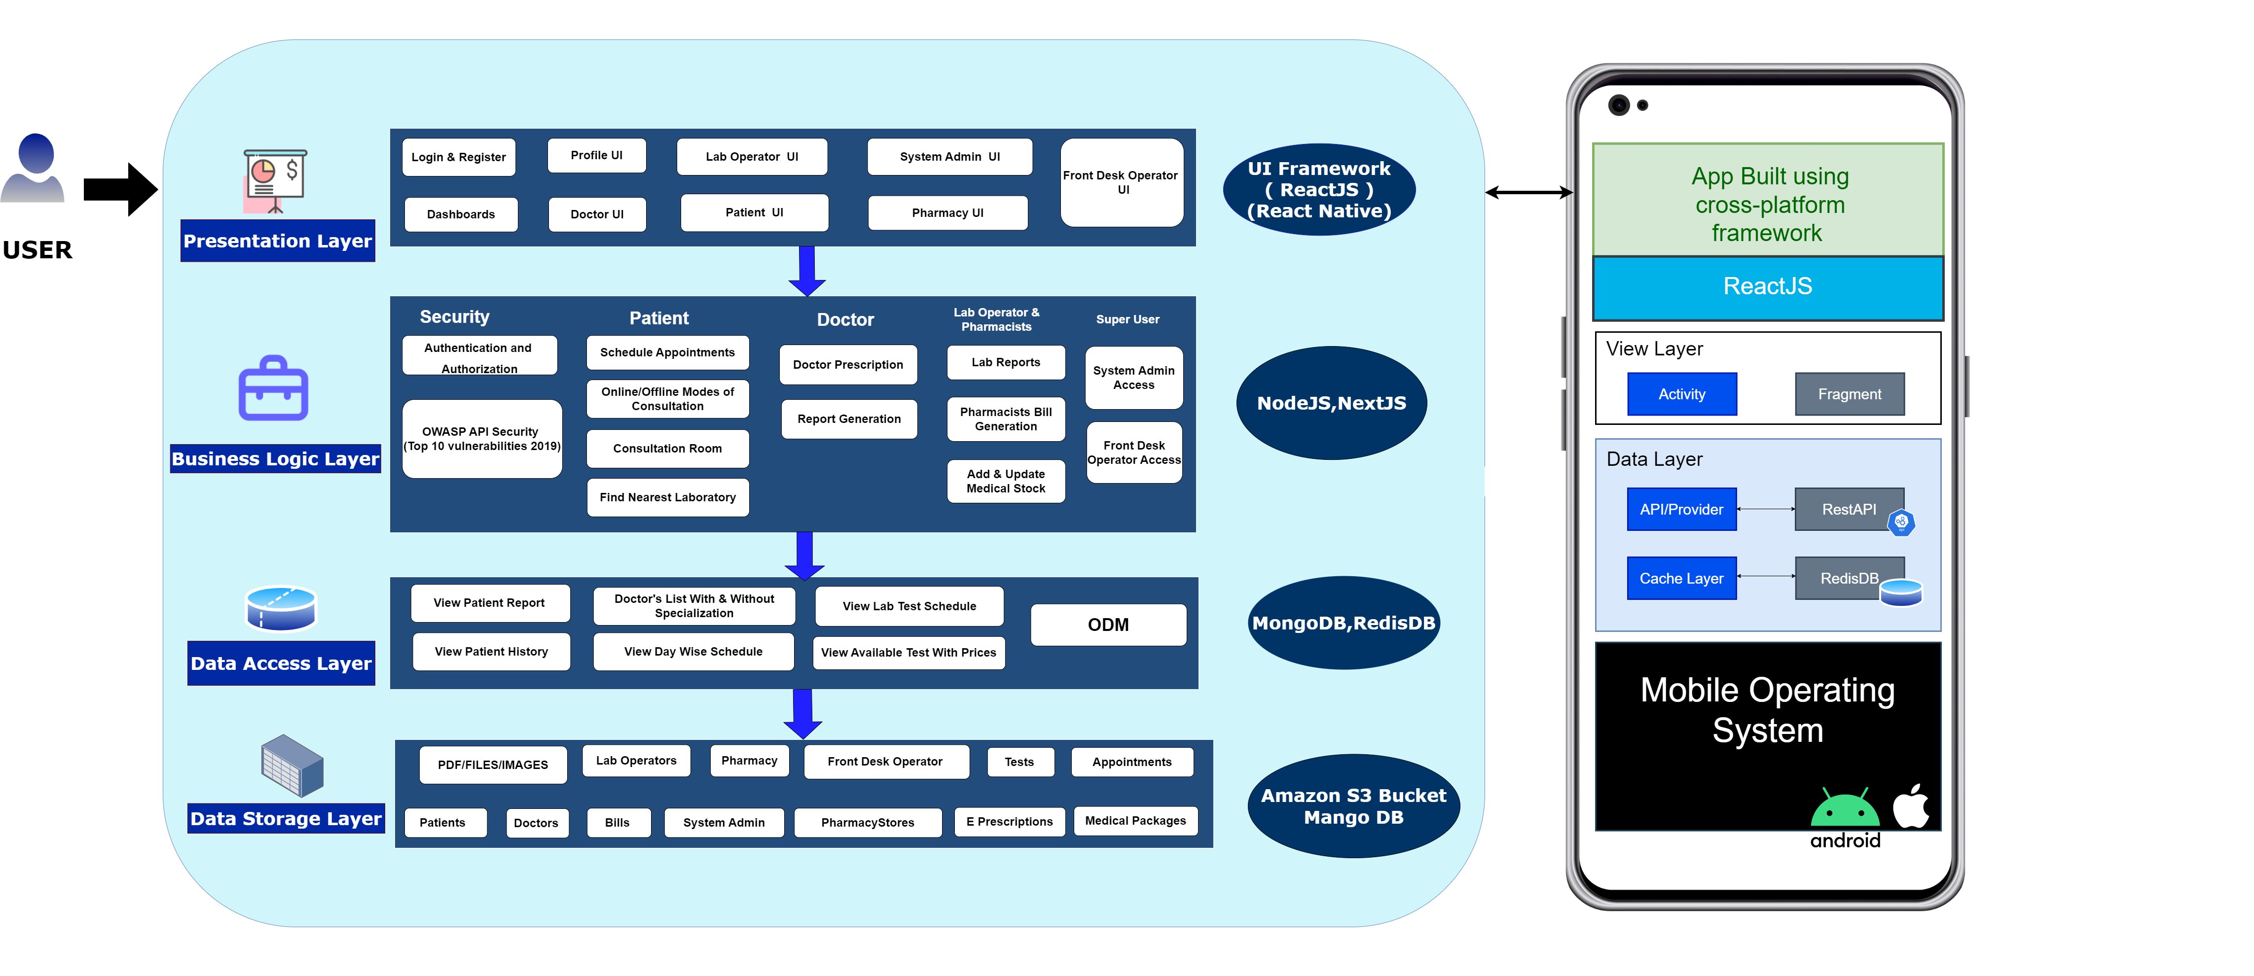
Architecture

Slide 11
IMPLEMENTATION STEPS
Development of Interfaces in Web Application and Mobile Application :
User interface (Login, Registration pages – Pharmacy / Lab operator / System Admin, Lab Admin)
Dashboard – Pharmacy, lab operator, System Admin / Lab Admin.
Jitsi meet Integration
Functions include – Medicine Booking , Selecting labs and pharmacy based on their location , various operations of lab admins and system admins.
Scheduling : Booking Slots for lab tests
Implementation of system features like Authentication & Security, User registrations

Slide 12
THANK YOU

